Slide 1
NOSQL
By Rajendra Prajapat(17BCS024)
Under the guidance of Prof. Uma S.

Slide 2
Twitter, Digg and Reddit and many other Web2.0 companies switched from MySQL to non­ relational database (NOSQL) to provide scalable data storage solutions.
Google File System based on BigTable and Amazon's Dynamo are very successful business NOSQL cases.

Slide 3
What is NOSQL? &
Why use NOSQL?

Slide 4
What is NOSQL
The abbreviation of "Not Only SQL." Means if RDB is suitable then use it while if RDB is not suitable to use, alternative can be used.
“Not only SQL”

Slide 5
NOSQL aims to solve
the needs of high concurrent read-write
efficient mass data storage and access
database scalability and high availability.

Slide 6
Why NOSQL?
Popularization of big data makes the enterprise need to store more and more data. The enterprise’s database must access data as fast as possible, but RDB has the speed limitation due to the join operation.
Its primary advantage is that, unlike relational databases, it handles unstructured data such as word-processing files, e-mail, multimedia, and social media efficiently.

Slide 7
The features of NoSQL

Slide 8
The features of NOSQL
Non-relational: NoSQL databases do not use Relational Database Model, neither support SQL Join operations.
Distributed: data in NoSQL databases is usually stored in different servers and the locations of the stored data are managed by metadata.
Horizontally scalable: the capacity of NoSQL database can be extended by increasing the number of servers.
High data processing rate: The data processing rate of NoSQL database is higher than that of RDB.

Slide 9
SQL vs NOSQL

Slide 10
SQL
NOSQL
Employee
ID | Name | Address | Age | salary
12 | Nitin | 53 | 21 | 250000
Address
Add_ID | House_N | city | State | pincod
53 | - | Hubli | Karnataka | 580023

Slide 11
SQL
NOSQL
Employee: {
ID:12,
Name: “Nitin”,
Address: {
City: Hubli,
State: Karnataka,
Pincode: 580029
},
Age: 21,
Salary: 250000
}
Employee
ID | Name | Address | Age | salary
12 | Nitin | 53 | 21 | 250000
Address
Add_ID | House_N | city | State | pincod
53 | _ | Hubli | Karnataka | 580023

Slide 12
SQL
NOSQL
Relational Database Management System
Fixed or static or predefined schema
Not suited for hierarchical data storage.
Best for complex queries
Vertically scalable
Non-Relational and Distributed database system
Doesn’t have fixed schema
Best suited for hierarchical data storage
Not good for complex queries
Horizontally scalable

Slide 13
Types of NOSQL

Slide 14
Key-Value Pair Based
The data in this NoSQL database is stored with the format of “Key ---> Value” where-
“Key” is a string used to identify the unique “Value;”
“Value” is the real data which can be number, string, or a JSON file, etc.;
The user can search for a certain “Value” by a specific “Key.”
Used by Redis and DynamoDB

Slide 15
example
Key-Value Pair Based
Key(Roll_N) value(JSON)
17BCS019 {
“Name”: “Nitin”,
“Age”:21,
“Marks”:100
}
17BCS033 {
“Name”: “Vivek”,
“Age”:21,
“Marks”:75
}

Slide 16
2. Column Based
Column-Oriented Database work on columns and are based on Bigtable paper by google.
A Row Key is an identification that has a unique value used to identify a specific record, similar to the primary key of a relation in RDB
A Timestamp is an integer used to identify a specific version of a data value.
Apache Cassandra and Apache HBase

Slide 17
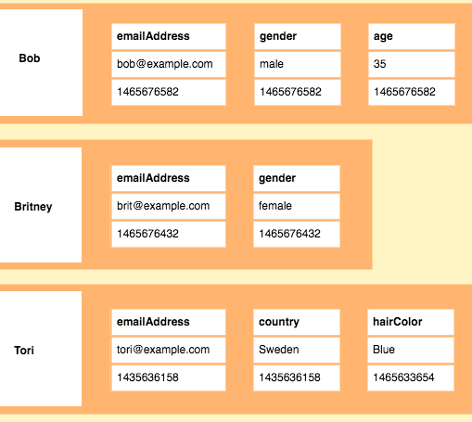
example
2. Column Based

Slide 18
3. Document Oriented
This NoSQL database stores data with files of semi-structured documents which have specific formats such as XML or JSON.
Stores and retrieves data as a key value pair but the value part is stored as a document.
Mostly used for CMS system, Blogging, real-time analytics and e-commerce applications.
FireStore, MongoDB and Couchbase

Slide 19
example
3. Document Oriented
{
{
“Name”: “Nitin”,
“Age”:21,
“Marks”:100
},
{
“Name”: “Vivek”,
“Age”:21,
“Marks”:75
}
}

Slide 20
4. Graph Based
A graph type database stores entities as well the relations amongst those entities.
The entity is stored as a node with the relationship as edges.
Graph database is a multi-relational in nature.
Traversing relationship is fast
Graph based database mostly used for social networks, logistics, spatial data.
Neo4J and OrientDB

Slide 21
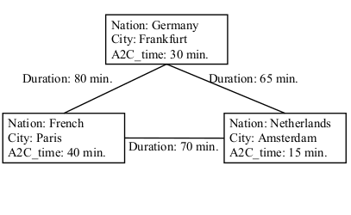
example
4. Graph Based

Slide 22
Other types of NOSQL Databases
Multimodel Databases:
Determine data features suitable processing based on the data format of a specific database.
OrientDB and ArangoDB
Object Database
The object-oriented concepts are used to describe the data itself and the relationship among the data.
Suitable for Computer Aided Design (CAD) and Office Automation
db4o and Versant
Grid and Cloud Database:
Applications that needs to search recent access data frequently.
Hazelcast and Oracle Coherence

Slide 23
Other types of NOSQL Databases- Cont.
XML Database:
Data stored in XML files
Oracle Berkeley DB and BaseX
Multidimensional Database:
Applications that often analyze data in multiple dimensions.
Intersystems Cache and GT.M
Multivalue Database:
Data with multivalued attributes or composite attributes
jBASE and Model 204
Time Series Database:
Data related to time series
Informix Time Series Solution and influxdata

Slide 24
There are more than 225 kinds of NoSQL databases.
How to choose an appropriate NoSQL database for a specific enterprise is very important because the change of database may affect the enterprise performance of the business operations?

Slide 25
Principle of
Database Selection

Slide 26
Principles of Database Selection
Understand the current problems, goals, and challenges of the corporate operations database.
Determine to continue to use current RDB or to change to use NoSQL databases according to business requirements and features of NoSQL databases.
If changing to use NoSQL databases, select a suitable category of NoSQL databases based on the features and formats of the enterprise’s operating data.
When selecting a specific NoSQL database, we can first find out the NoSQL databases that are most frequently discussed on the Internet according to the statistics and evaluation of the DB-Engines Ranking website. Finally, based on the advantages and disadvantages of these databases and enterprise’s needs, we can select the most appropriate NoSQL database.

Slide 27
Advantages of NOSQL

Slide 28
Advantages of NOSQL
Can be used as Primary or Analytic Data Source
Big Data Capability
No Single Point of Failure
Easy Replication
It provides fast performance and horizontal scalability.
Can handle structured, semi-structured, and unstructured data with equal effect
Object-oriented programming which is easy to use and flexible
NoSQL databases don't need a dedicated high-performance server
Simple to implement than using RDBMS
It can serve as the primary data source for online applications.
Handles big data which manages data velocity, variety, volume, and complexity
Offers a flexible schema design which can easily be altered without downtime or service disruption

Slide 29
Disadvantages of NOSQL

Slide 30
Disadvantages of NOSQL
No standardization rules
Limited query capabilities
It does not offer any traditional database capabilities, like consistency when multiple transactions are performed simultaneously.
The learning curve is stiff for new developers
Open source options so not so popular for enterprises.

Slide 31


